Slide 1
MediCor AI

Slide 2
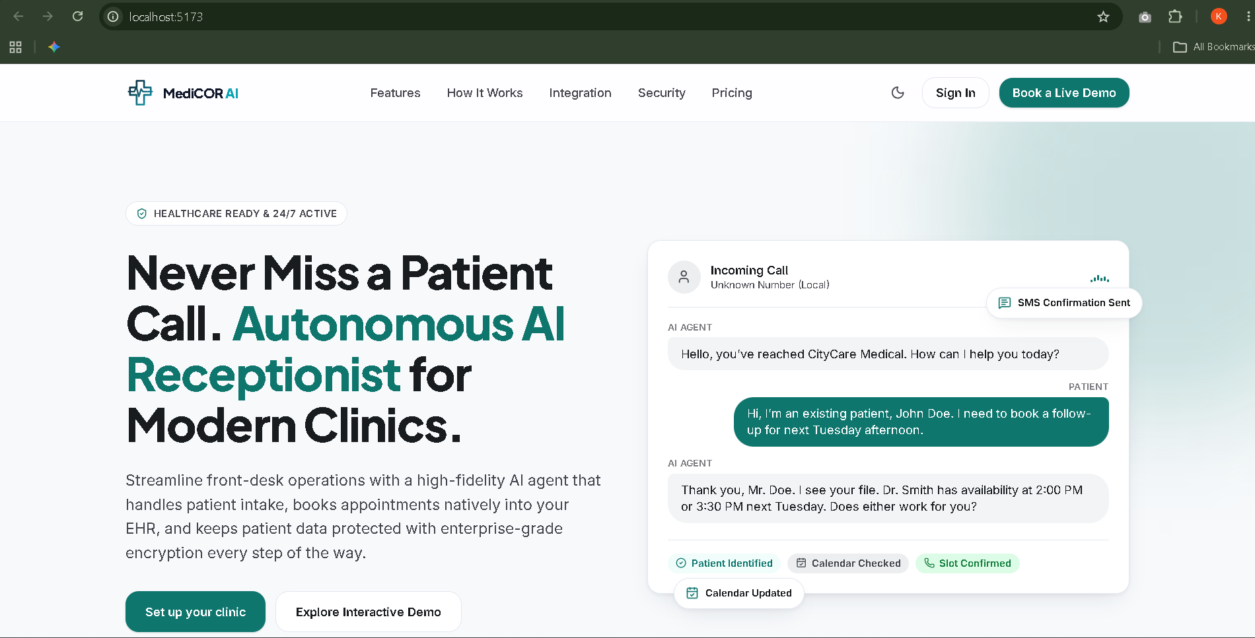

Slide 3
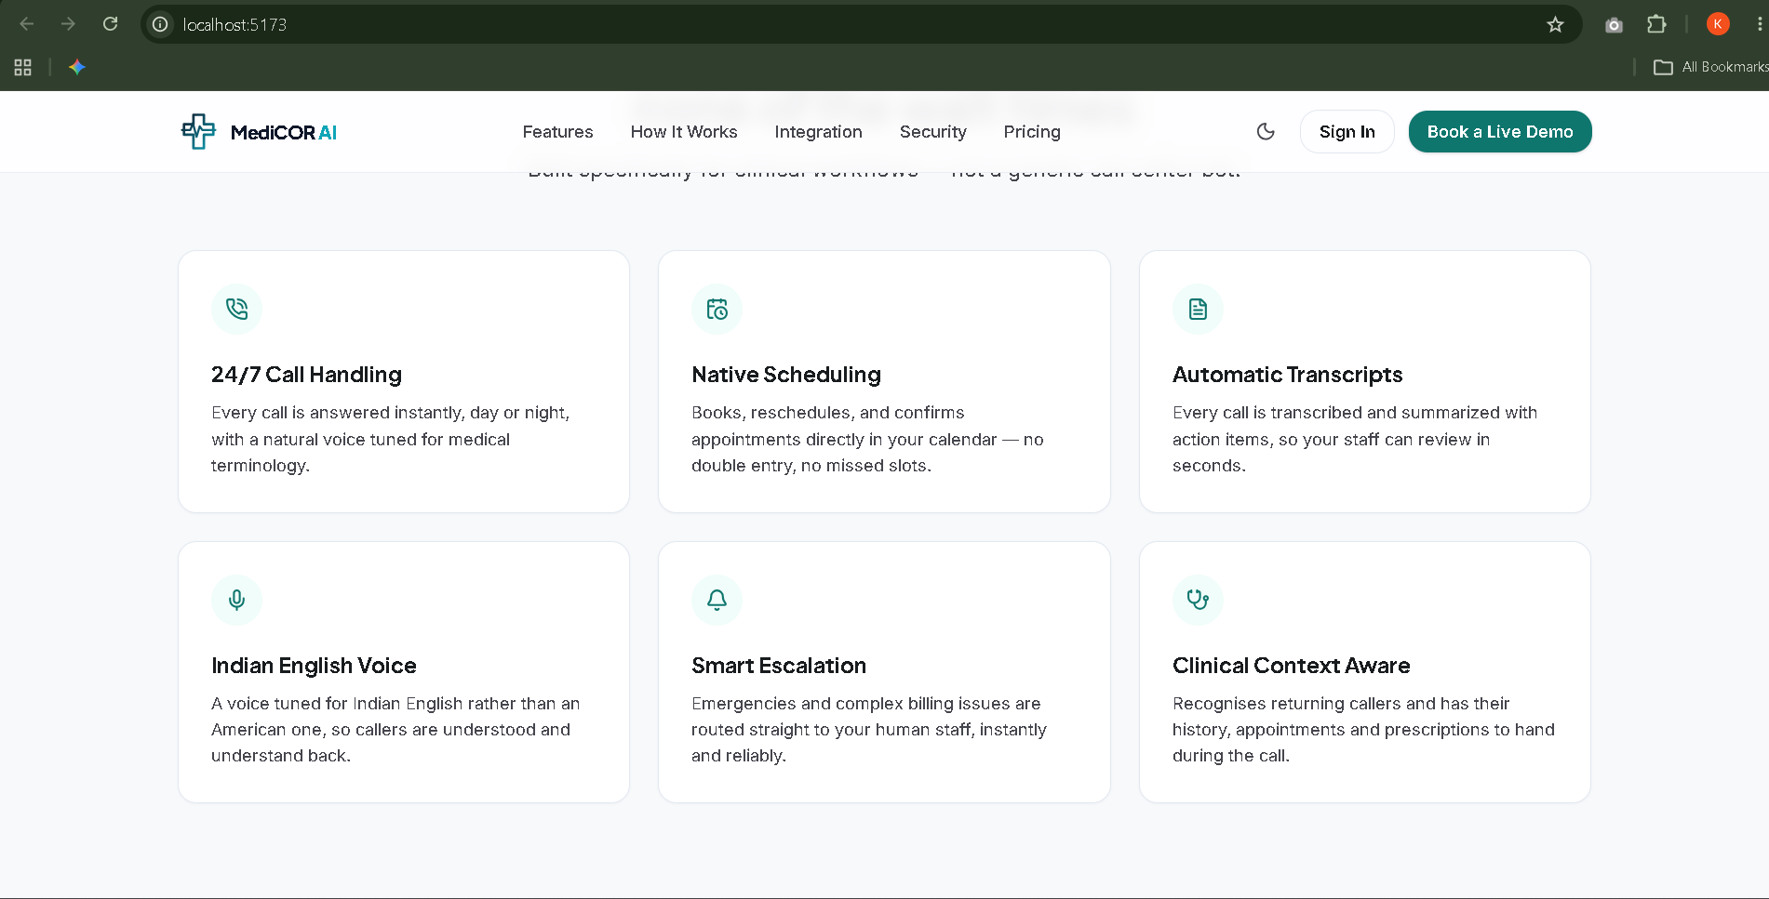

Slide 4
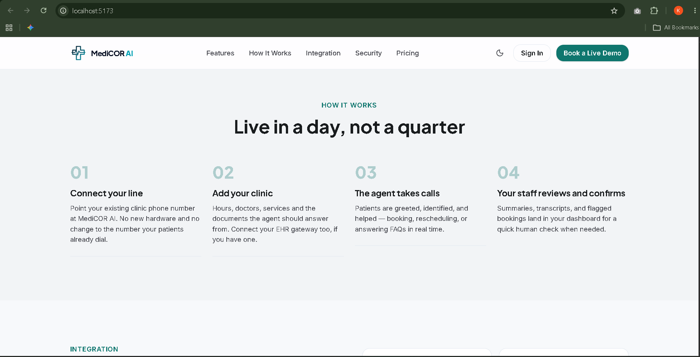

Slide 5
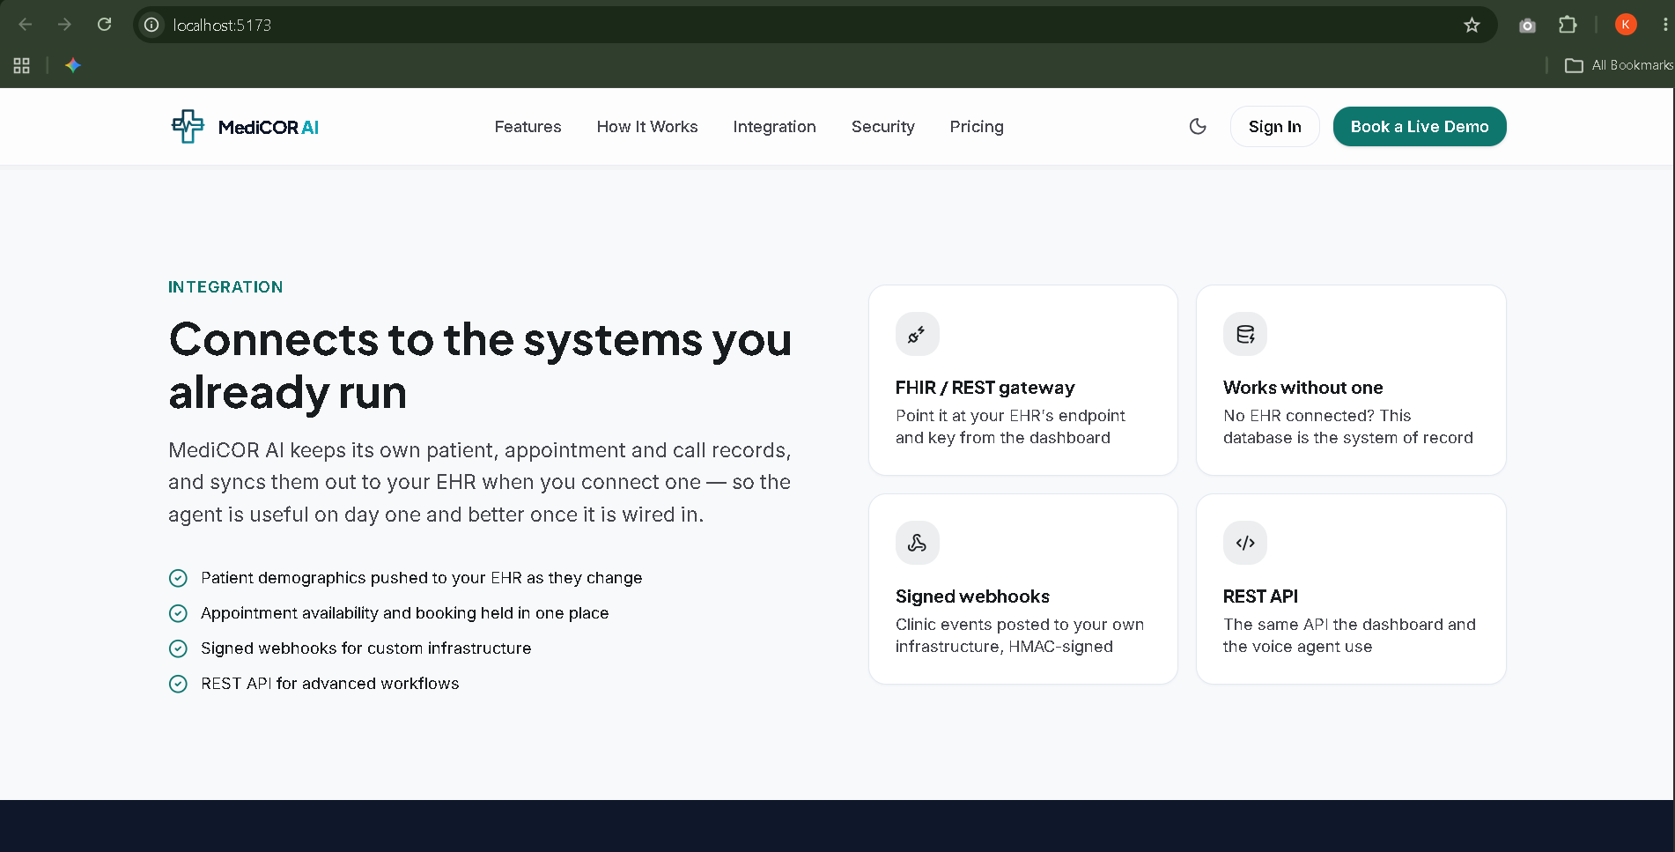

Slide 6
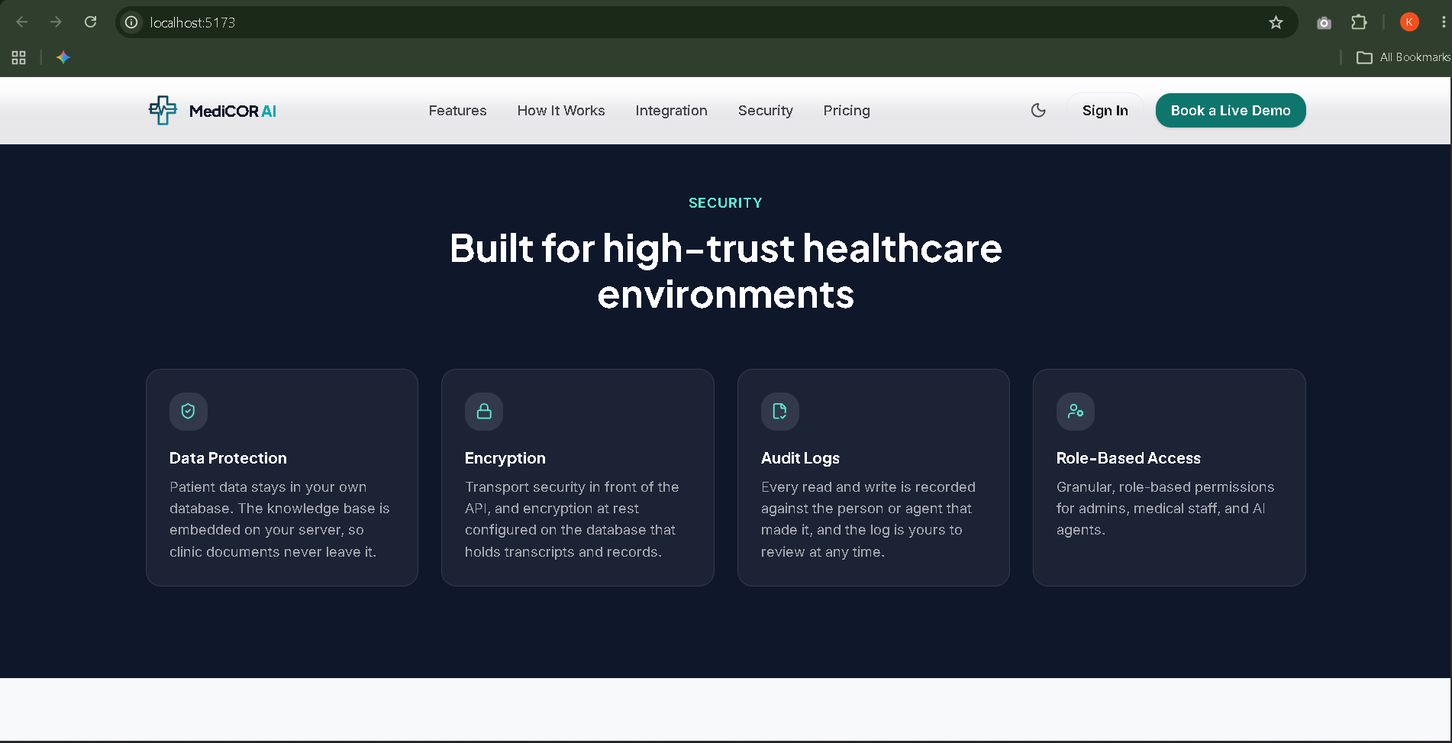

Slide 7
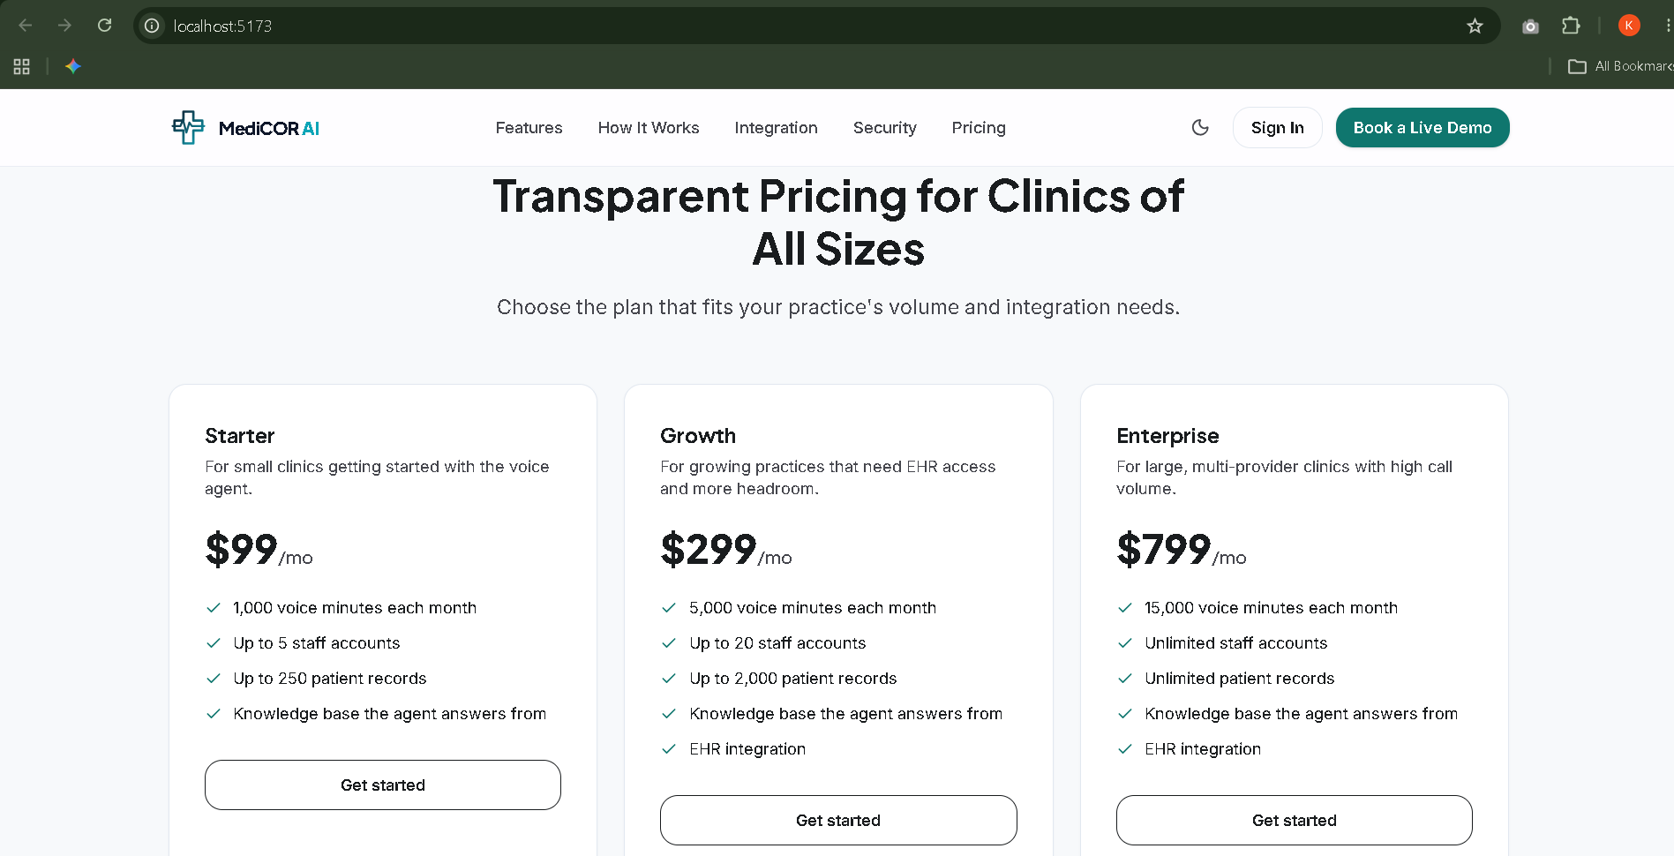

Slide 8
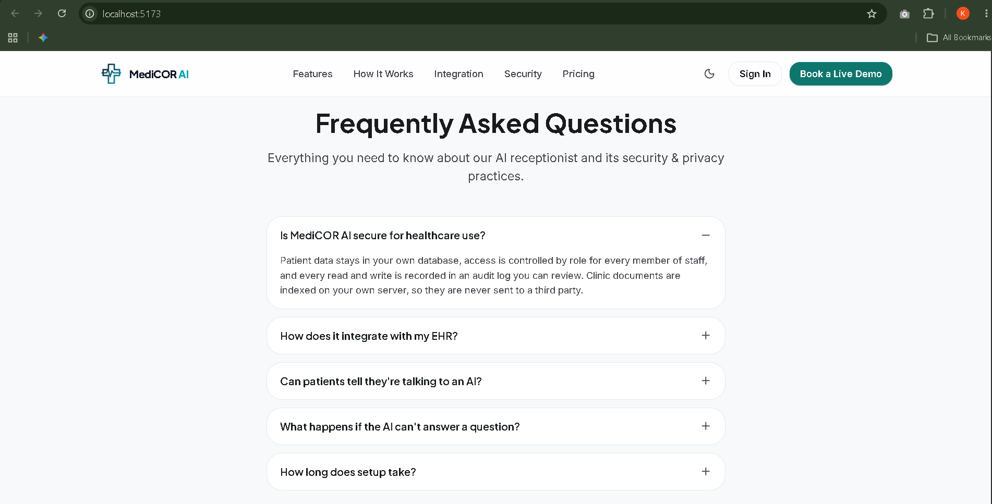

Slide 9
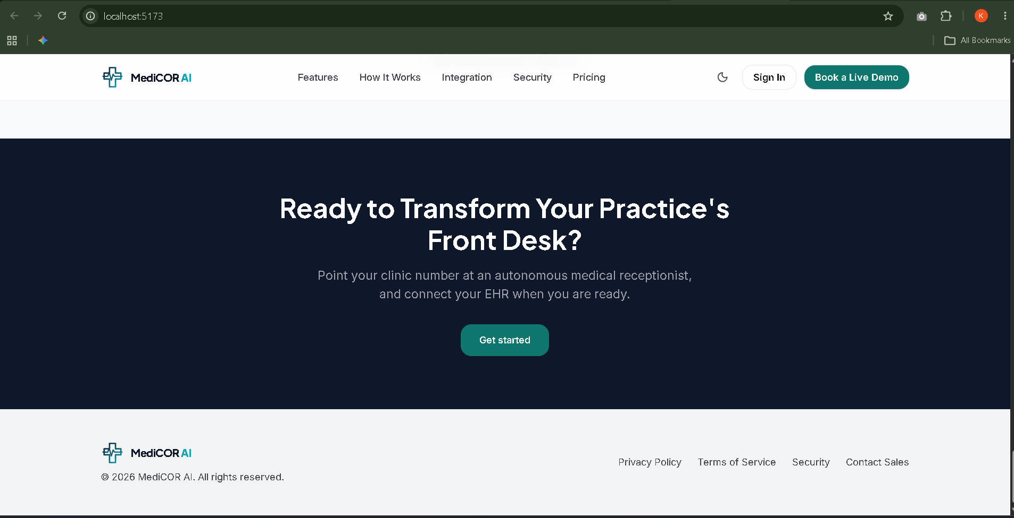

Slide 10
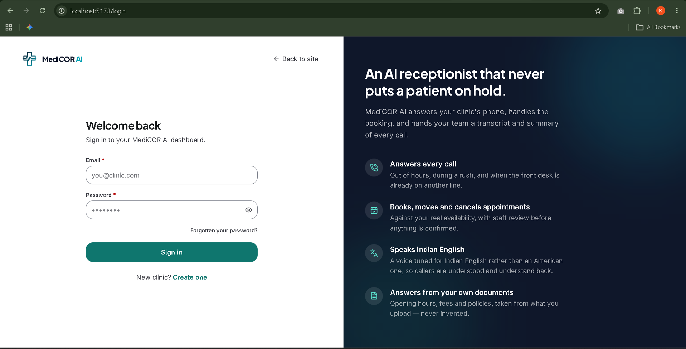

Slide 11
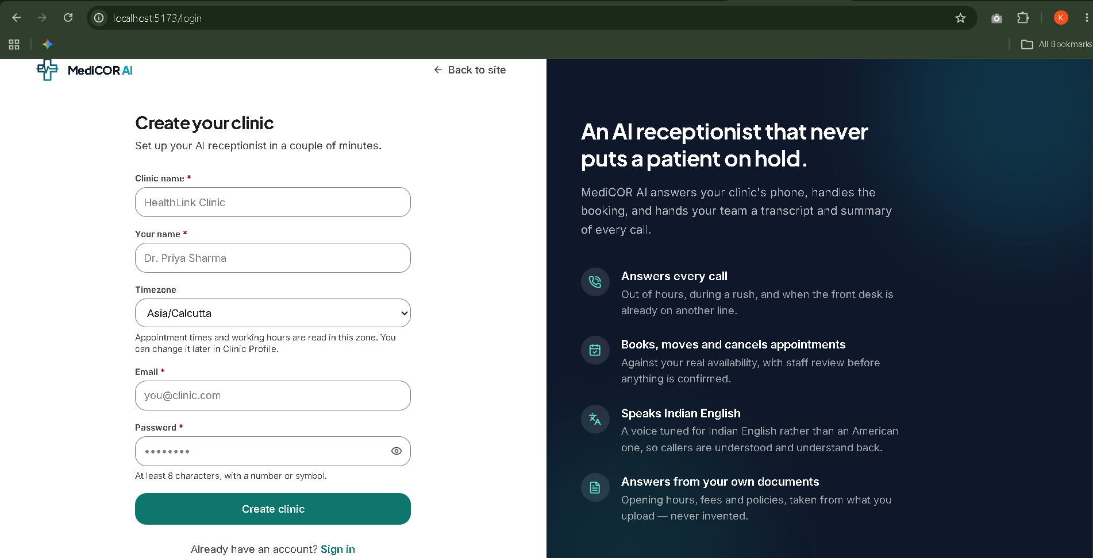

Slide 12
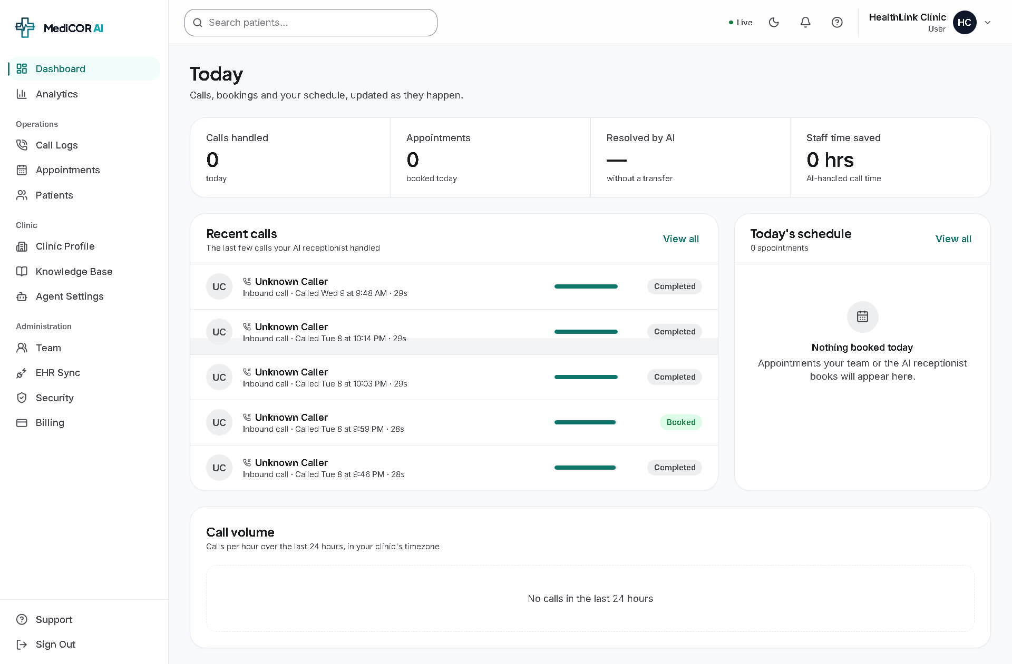

Slide 13
“The dashboard provides a real-time operational overview of the AI receptionist. Staff can quickly see calls handled, appointments booked, recent calls, today's schedule and call volume.”

Slide 14
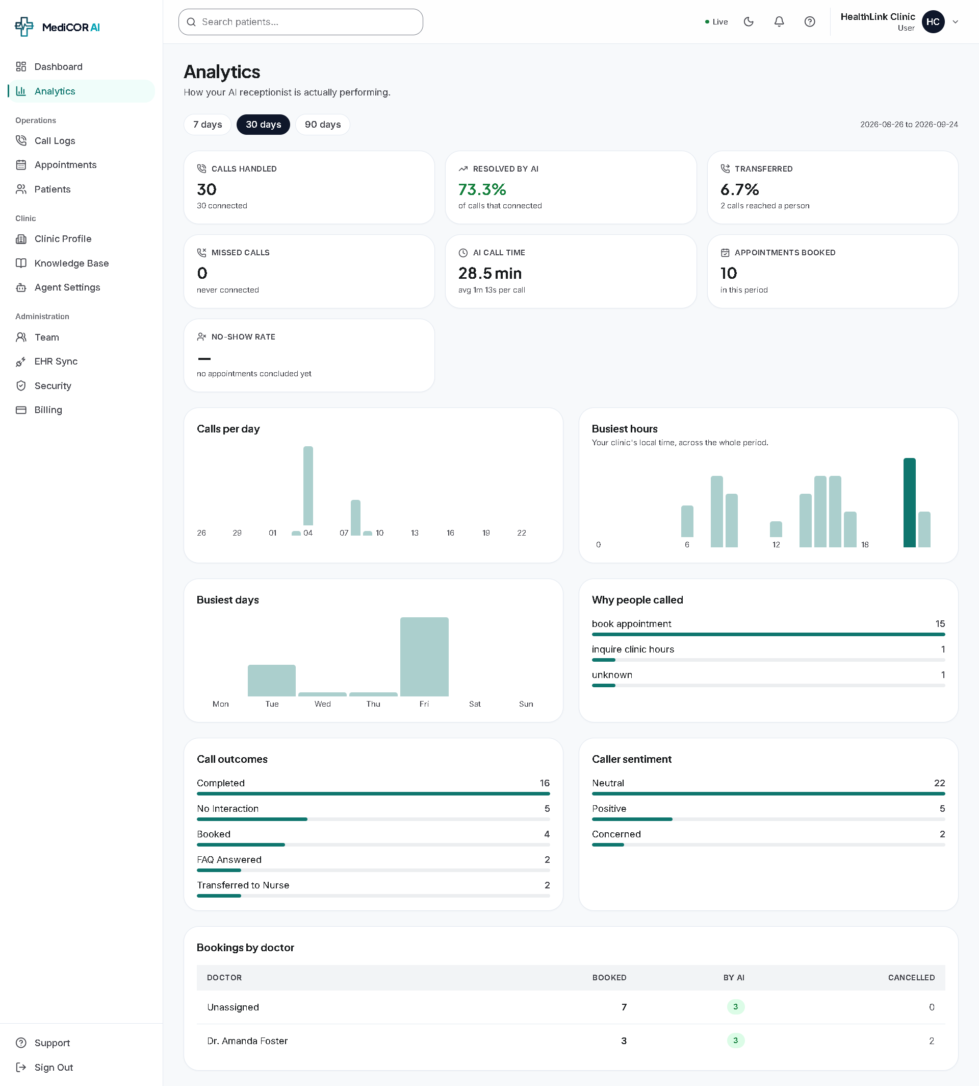
“Analytics helps the clinic understand how effectively the AI receptionist is performing. It provides call volumes, resolution rates, transfers, appointment bookings, call outcomes, caller sentiment and doctor-wise booking information.”

Slide 15
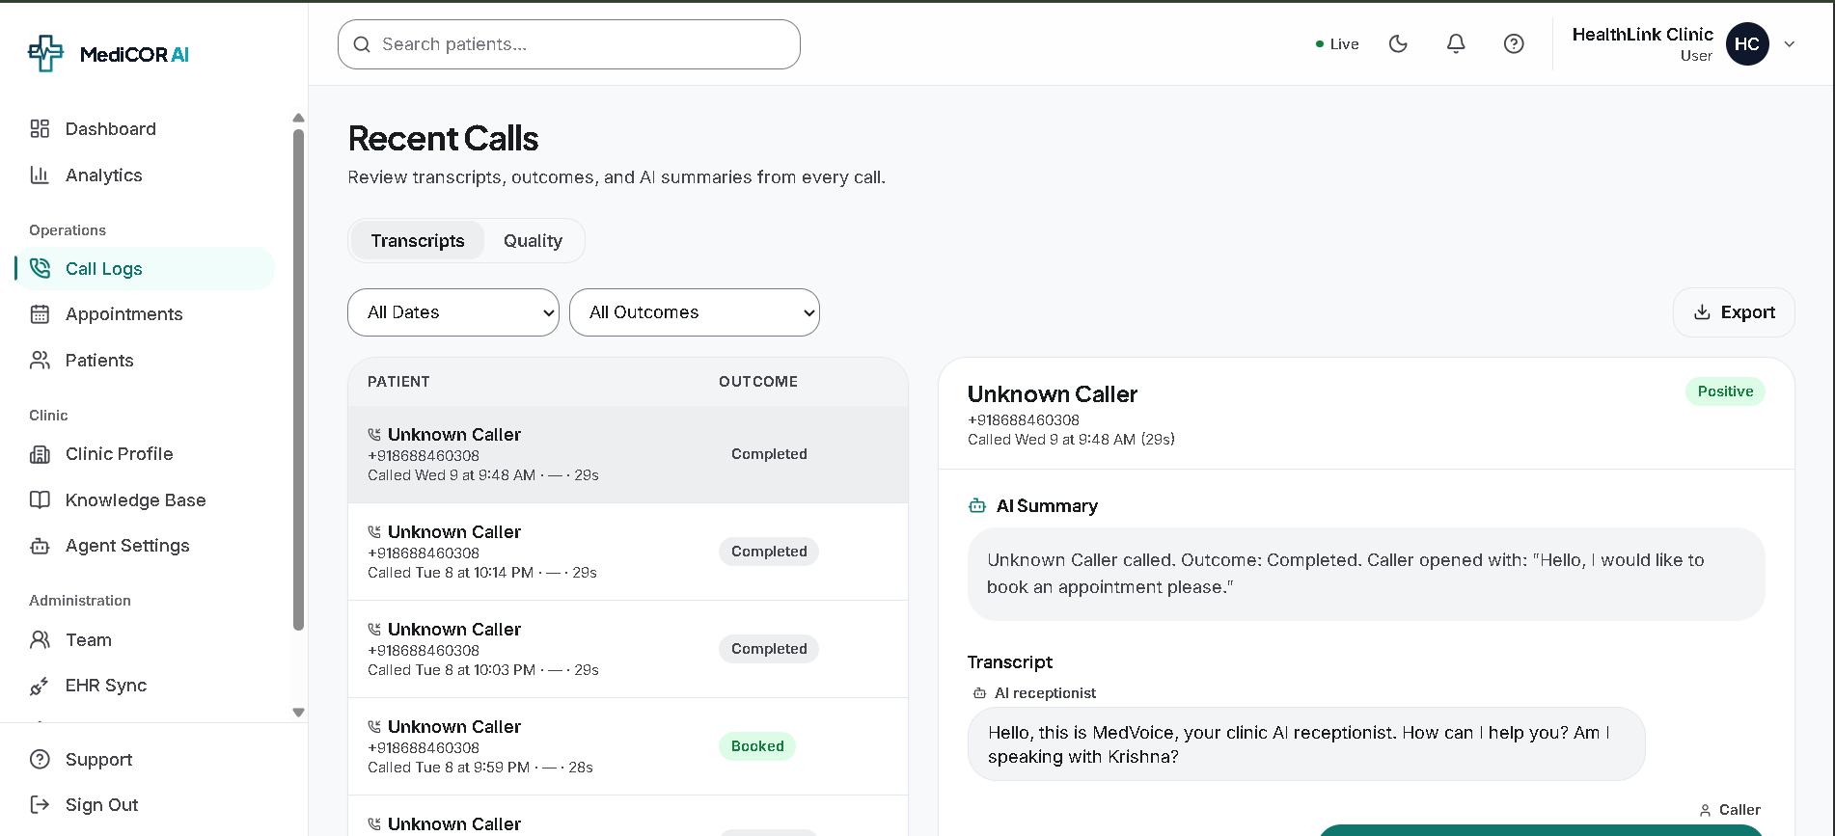
“Call Logs provide a complete history of AI-handled calls. Staff can review the call outcome, AI-generated summary and full conversation transcript, which helps with follow-up, quality review and operational monitoring.”

Slide 16
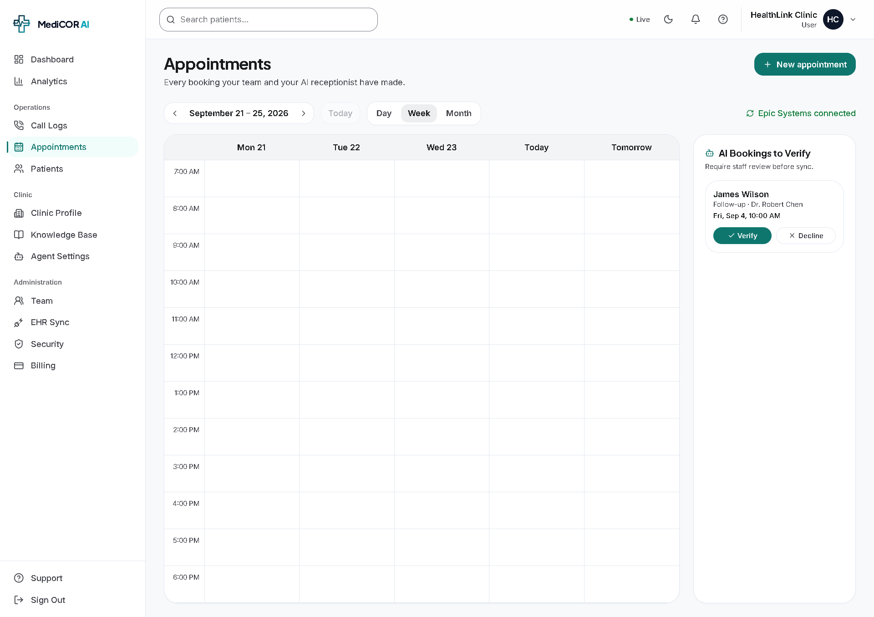
“This is the appointment management screen. Clinic staff can view their schedule in day, week or month format and manage appointments. AI-generated bookings can also be reviewed and verified before they are synchronized with the clinic's system.”

Slide 17
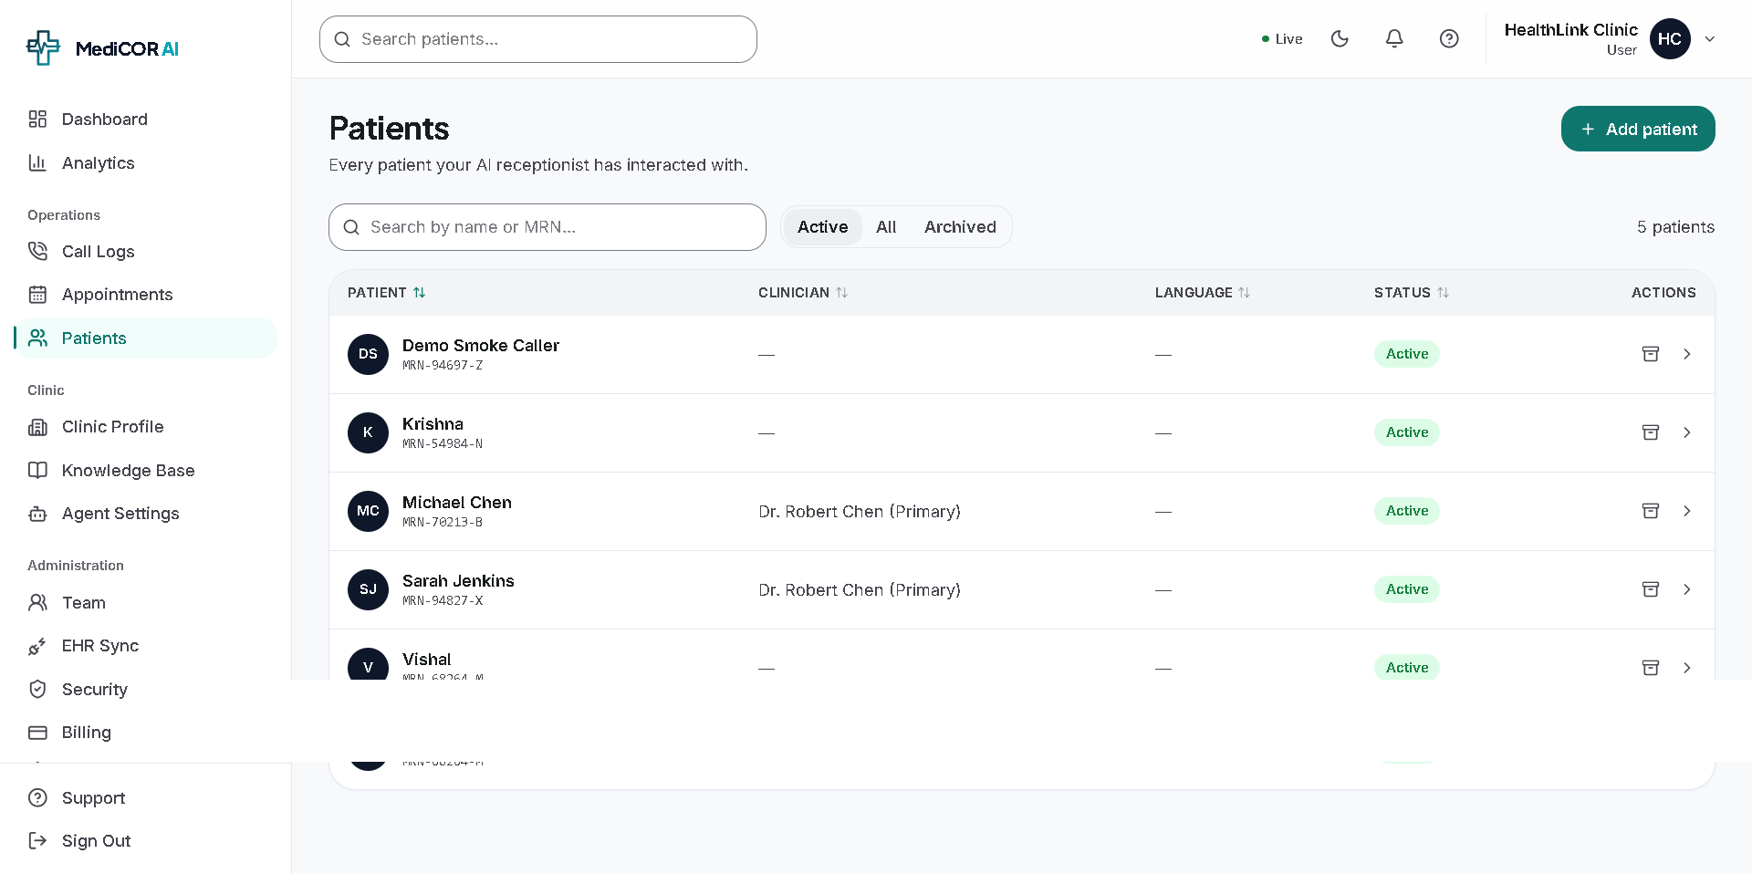
“The Patients module provides the clinic with a centralized list of patients who have interacted with the AI receptionist. Staff can search patients using their name or medical record number and view their associated information and status.”

Slide 18
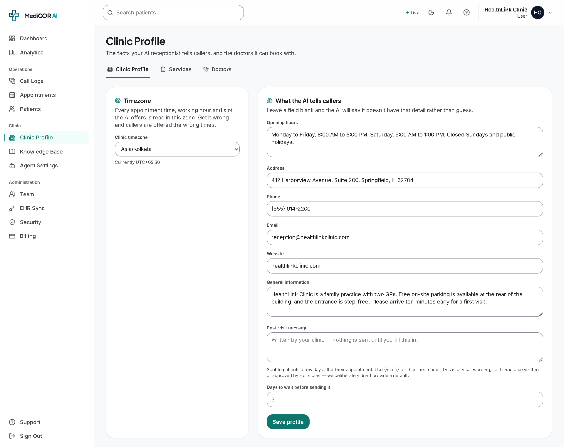
“The Clinic Profile defines the basic information that the AI receptionist uses when answering patient questions. This includes clinic hours, contact information, location and general information. The system is designed to avoid inventing information when a detail has not been provided.”

Slide 19
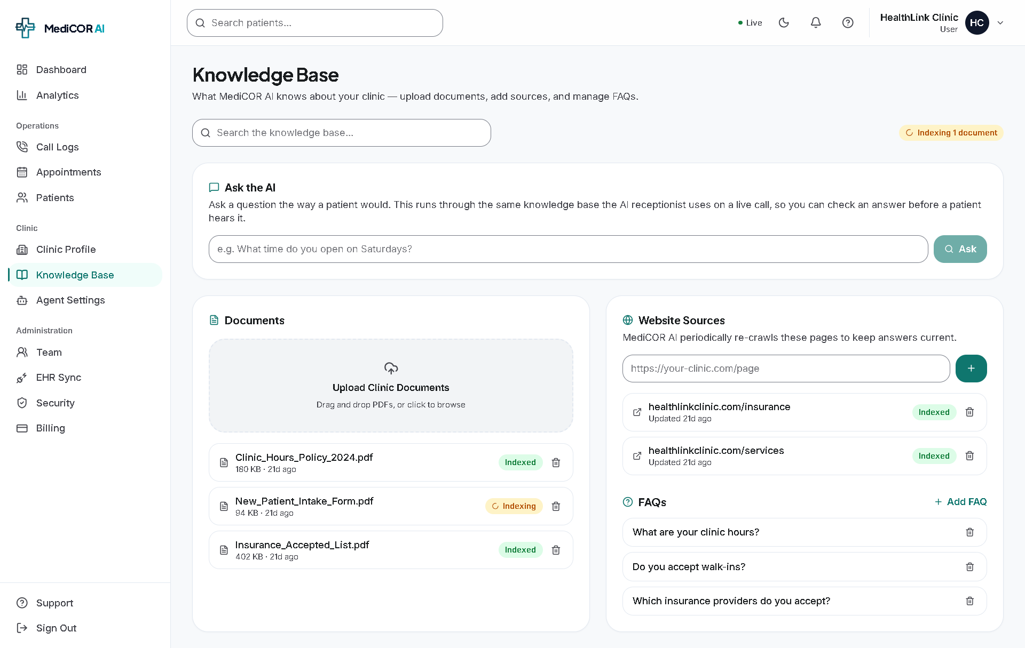
“The Knowledge Base allows the clinic to provide trusted information to the AI through documents, website sources and FAQs. The same knowledge base is used by the AI receptionist when answering patient questions during calls.”

Slide 20
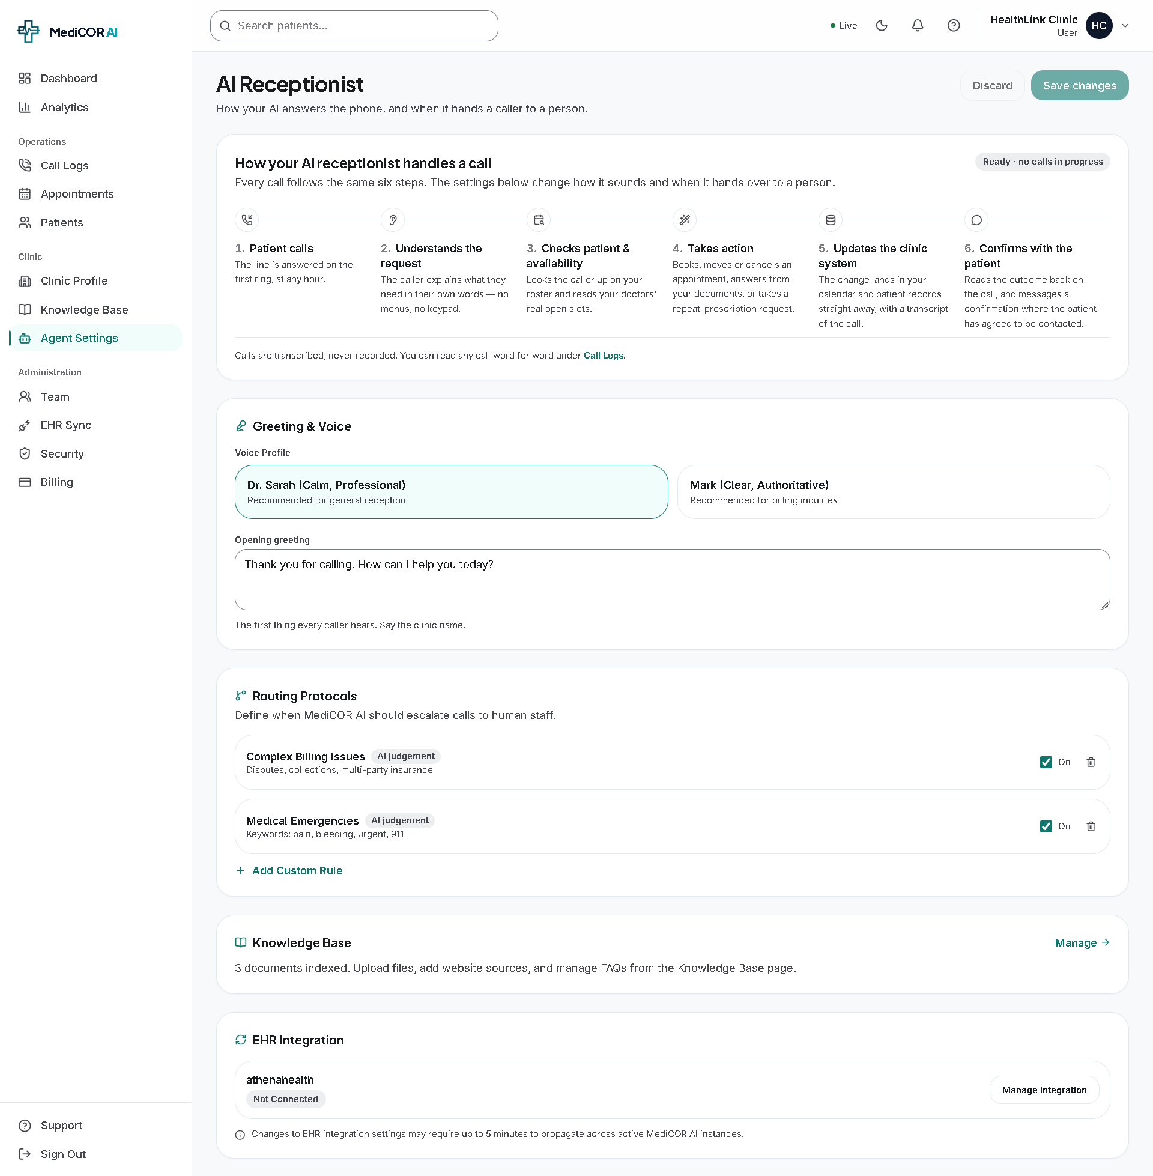
“This is the control center for the AI receptionist. Clinic administrators can configure the AI's voice and greeting, define escalation rules, manage its knowledge source and configure EHR integration.”

Slide 21
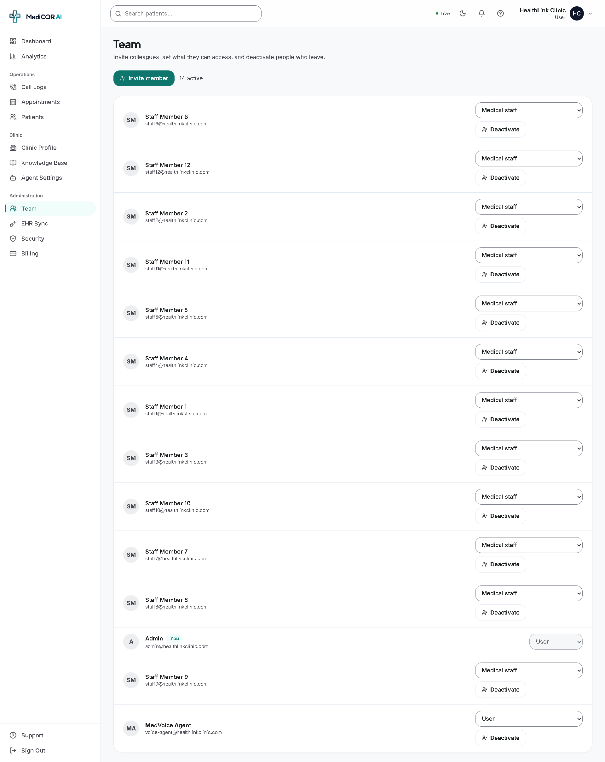
“The Team module allows the clinic administrator to manage staff access. They can invite new members, assign appropriate roles and deactivate users when they no longer require access.”

Slide 22
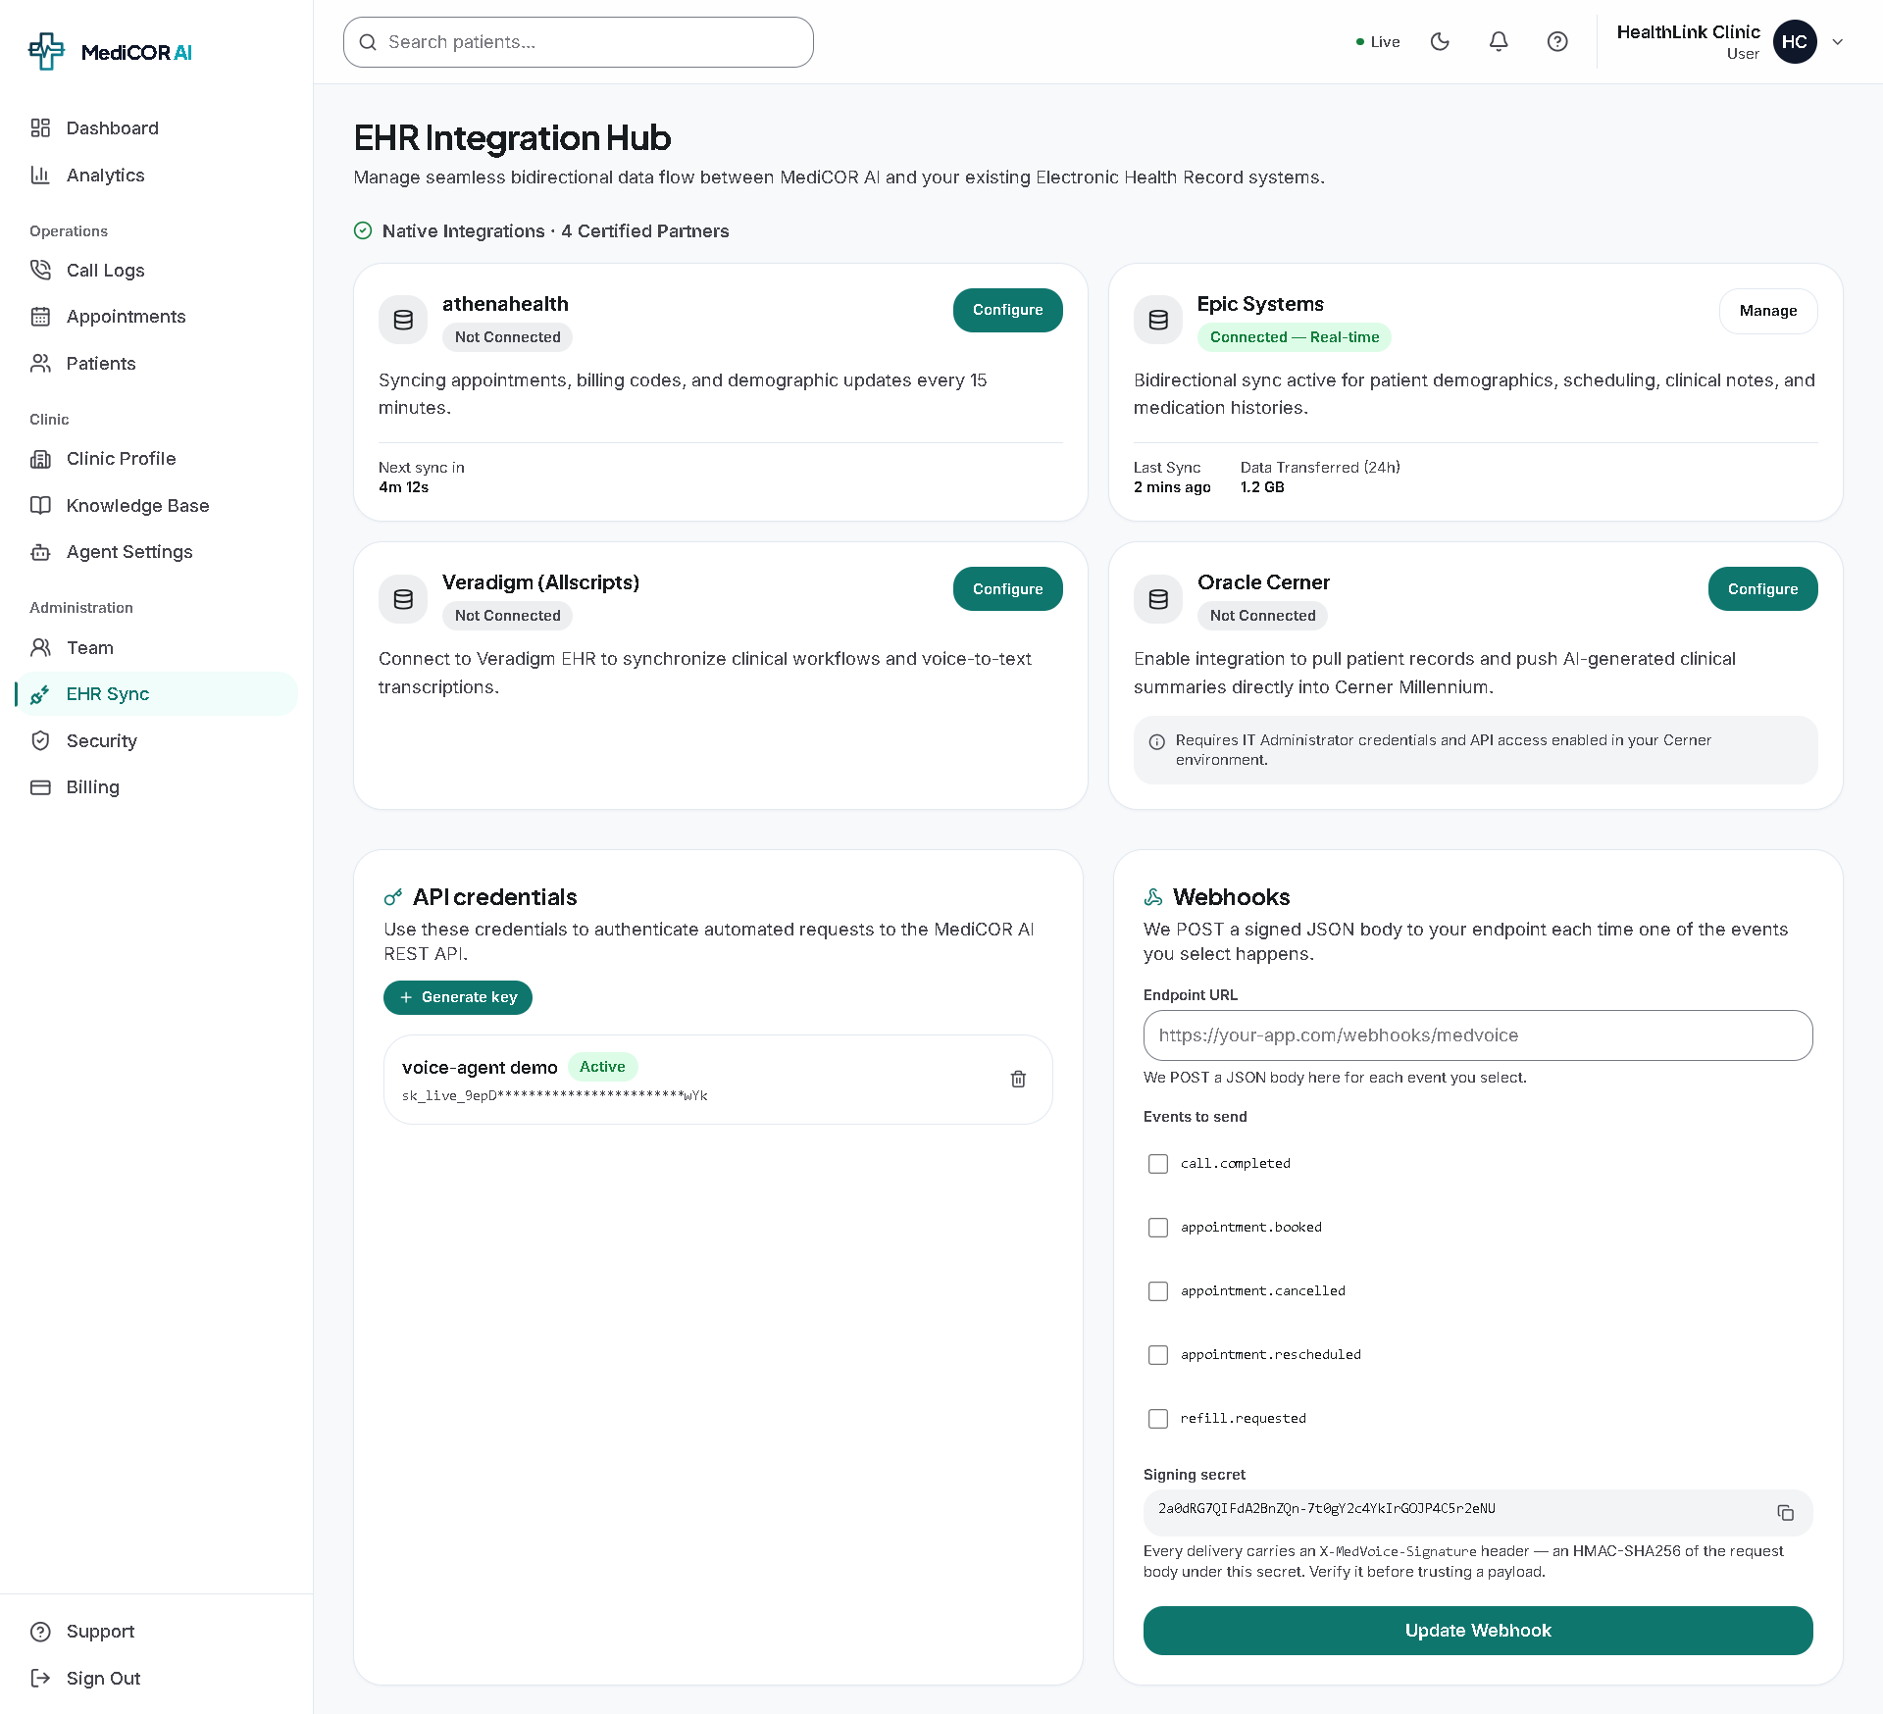
“The EHR Integration Hub connects MediCOR AI with external healthcare systems. It supports EHR synchronization, API credentials and webhooks so information and events can move between MediCOR AI and the clinic's existing systems.”

Slide 23
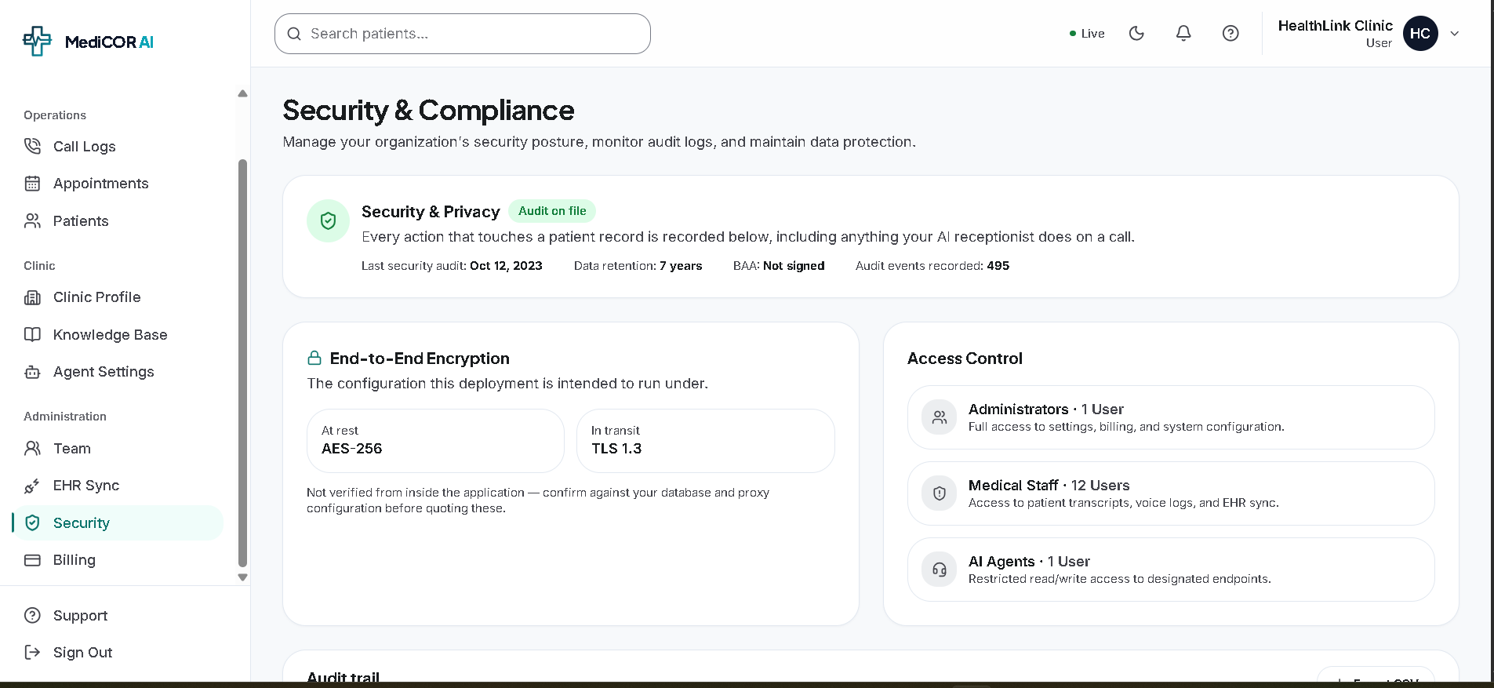
“The Security section provides visibility into the clinic's security configuration, access controls, encryption settings and audit activity. It also maintains a record of important actions performed within the clinic environment.”

Slide 24
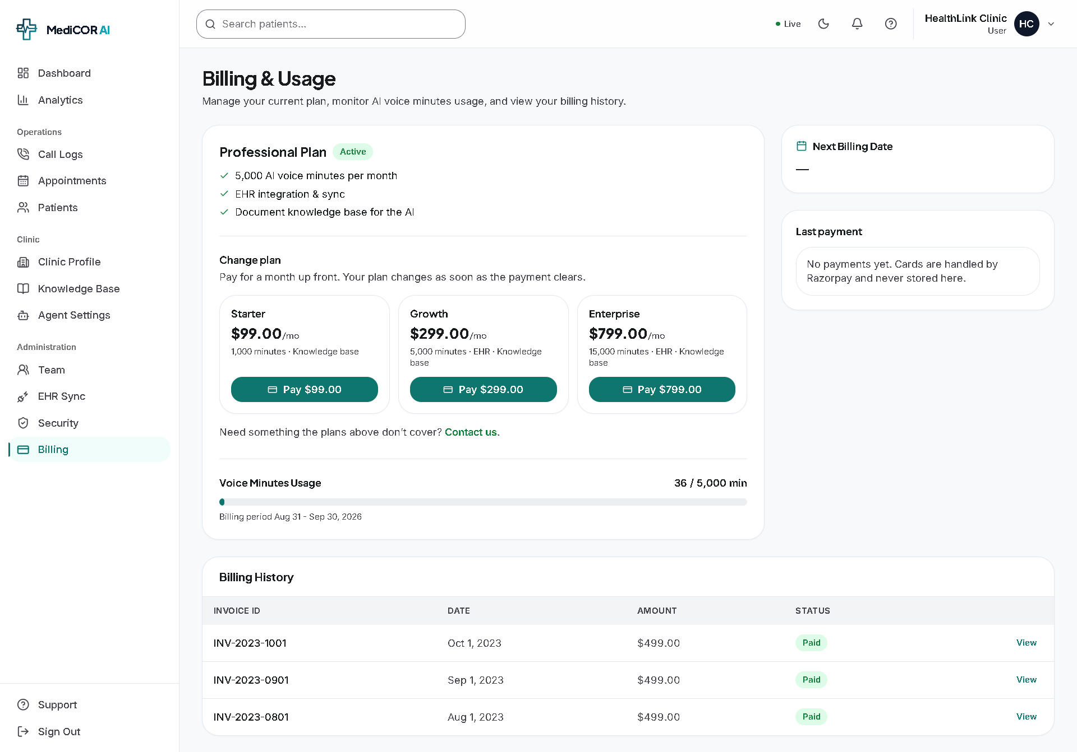
“Billing & Usage allows the clinic to manage its subscription, monitor AI voice-minute consumption, change plans and review billing history.”

Slide 25
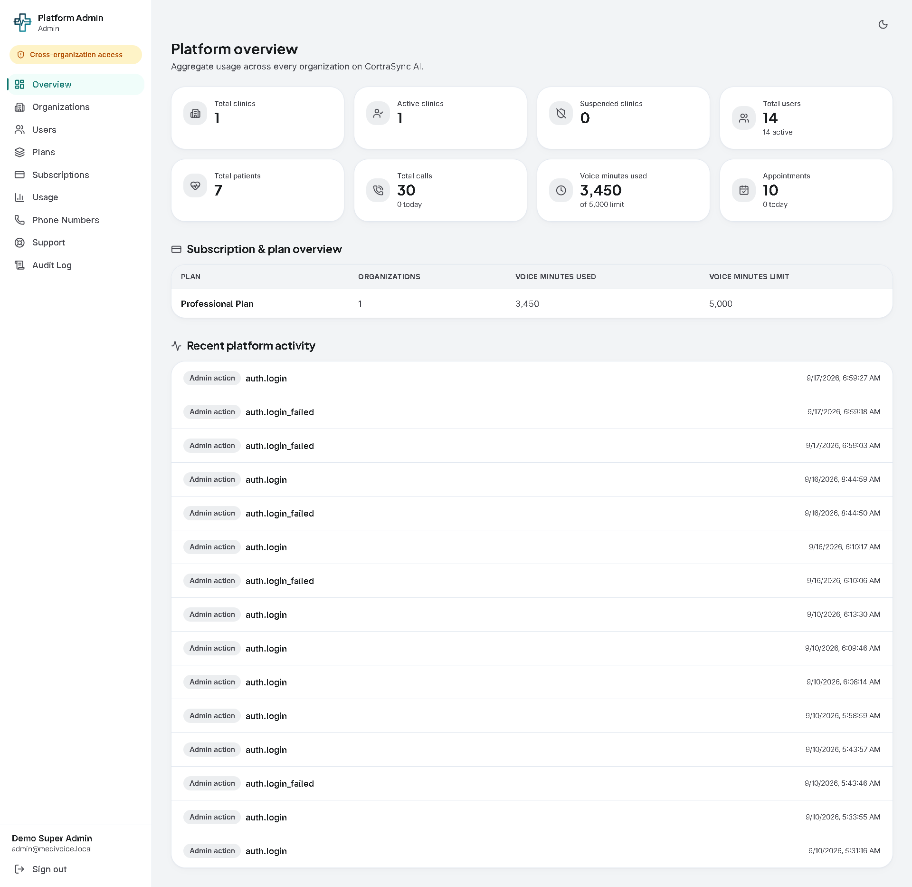
“The Platform Overview provides the platform administrator with a centralized view of the entire MediCOR AI SaaS environment, including clinics, users, patients, calls, appointments, voice usage, subscriptions and recent administrative activity.”

Slide 26
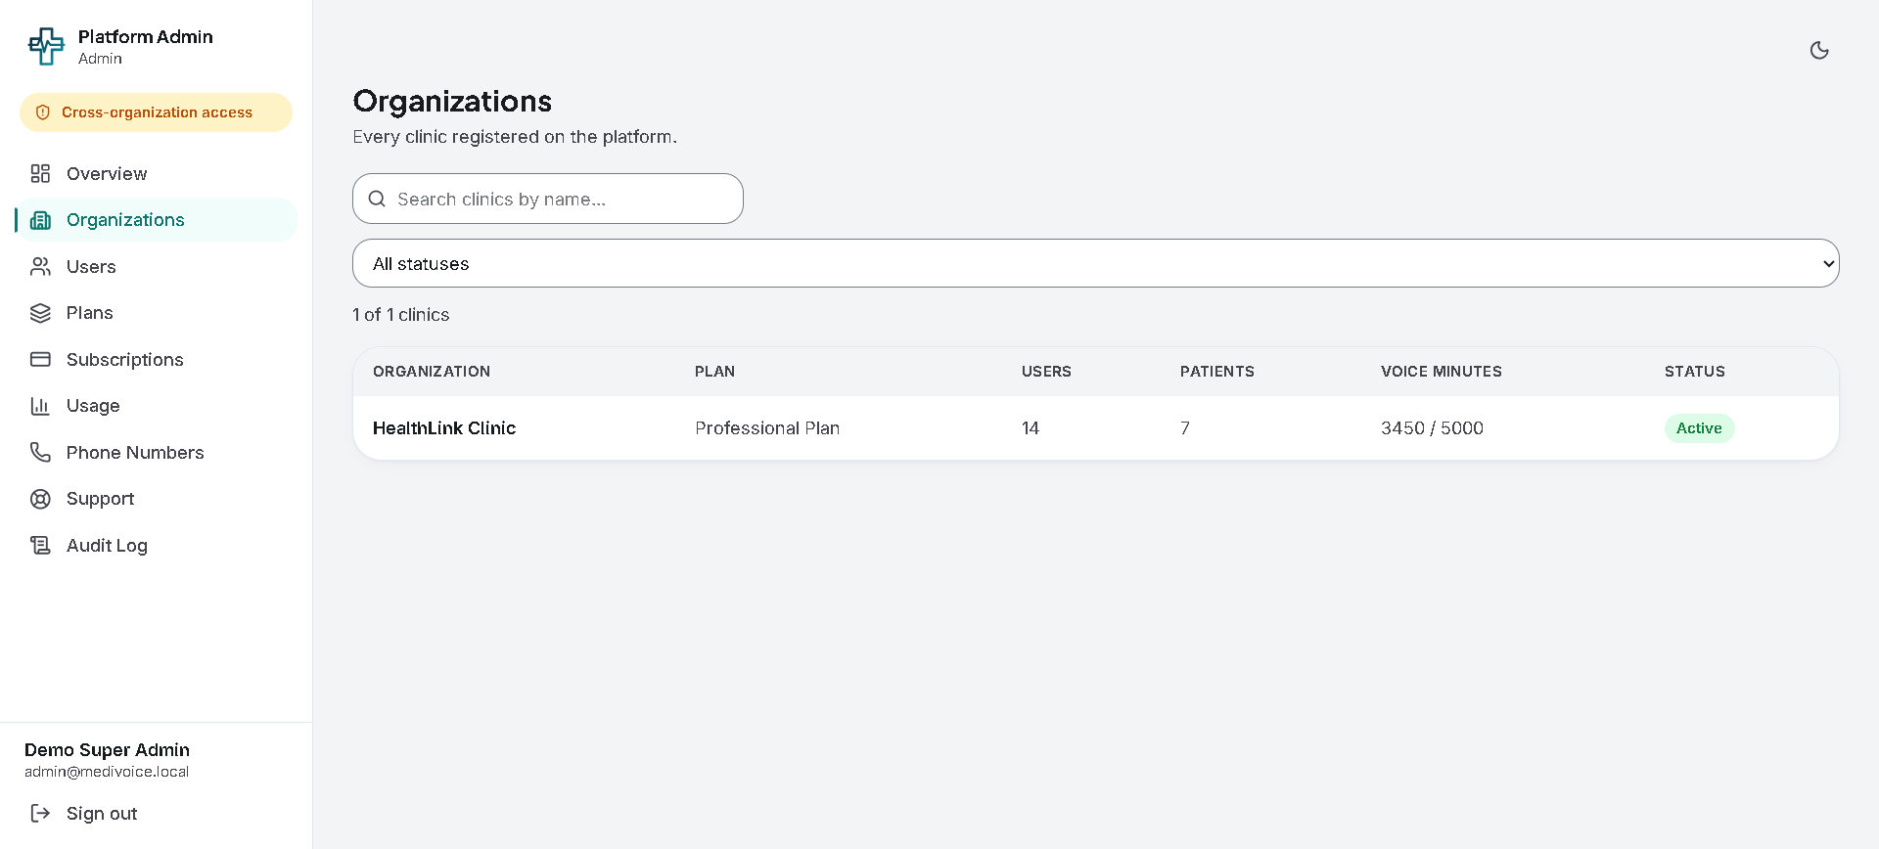
“The Organizations module provides the Platform Admin with a centralized list of all clinics registered on MediCOR AI and their current subscription, usage and status.”

Slide 27
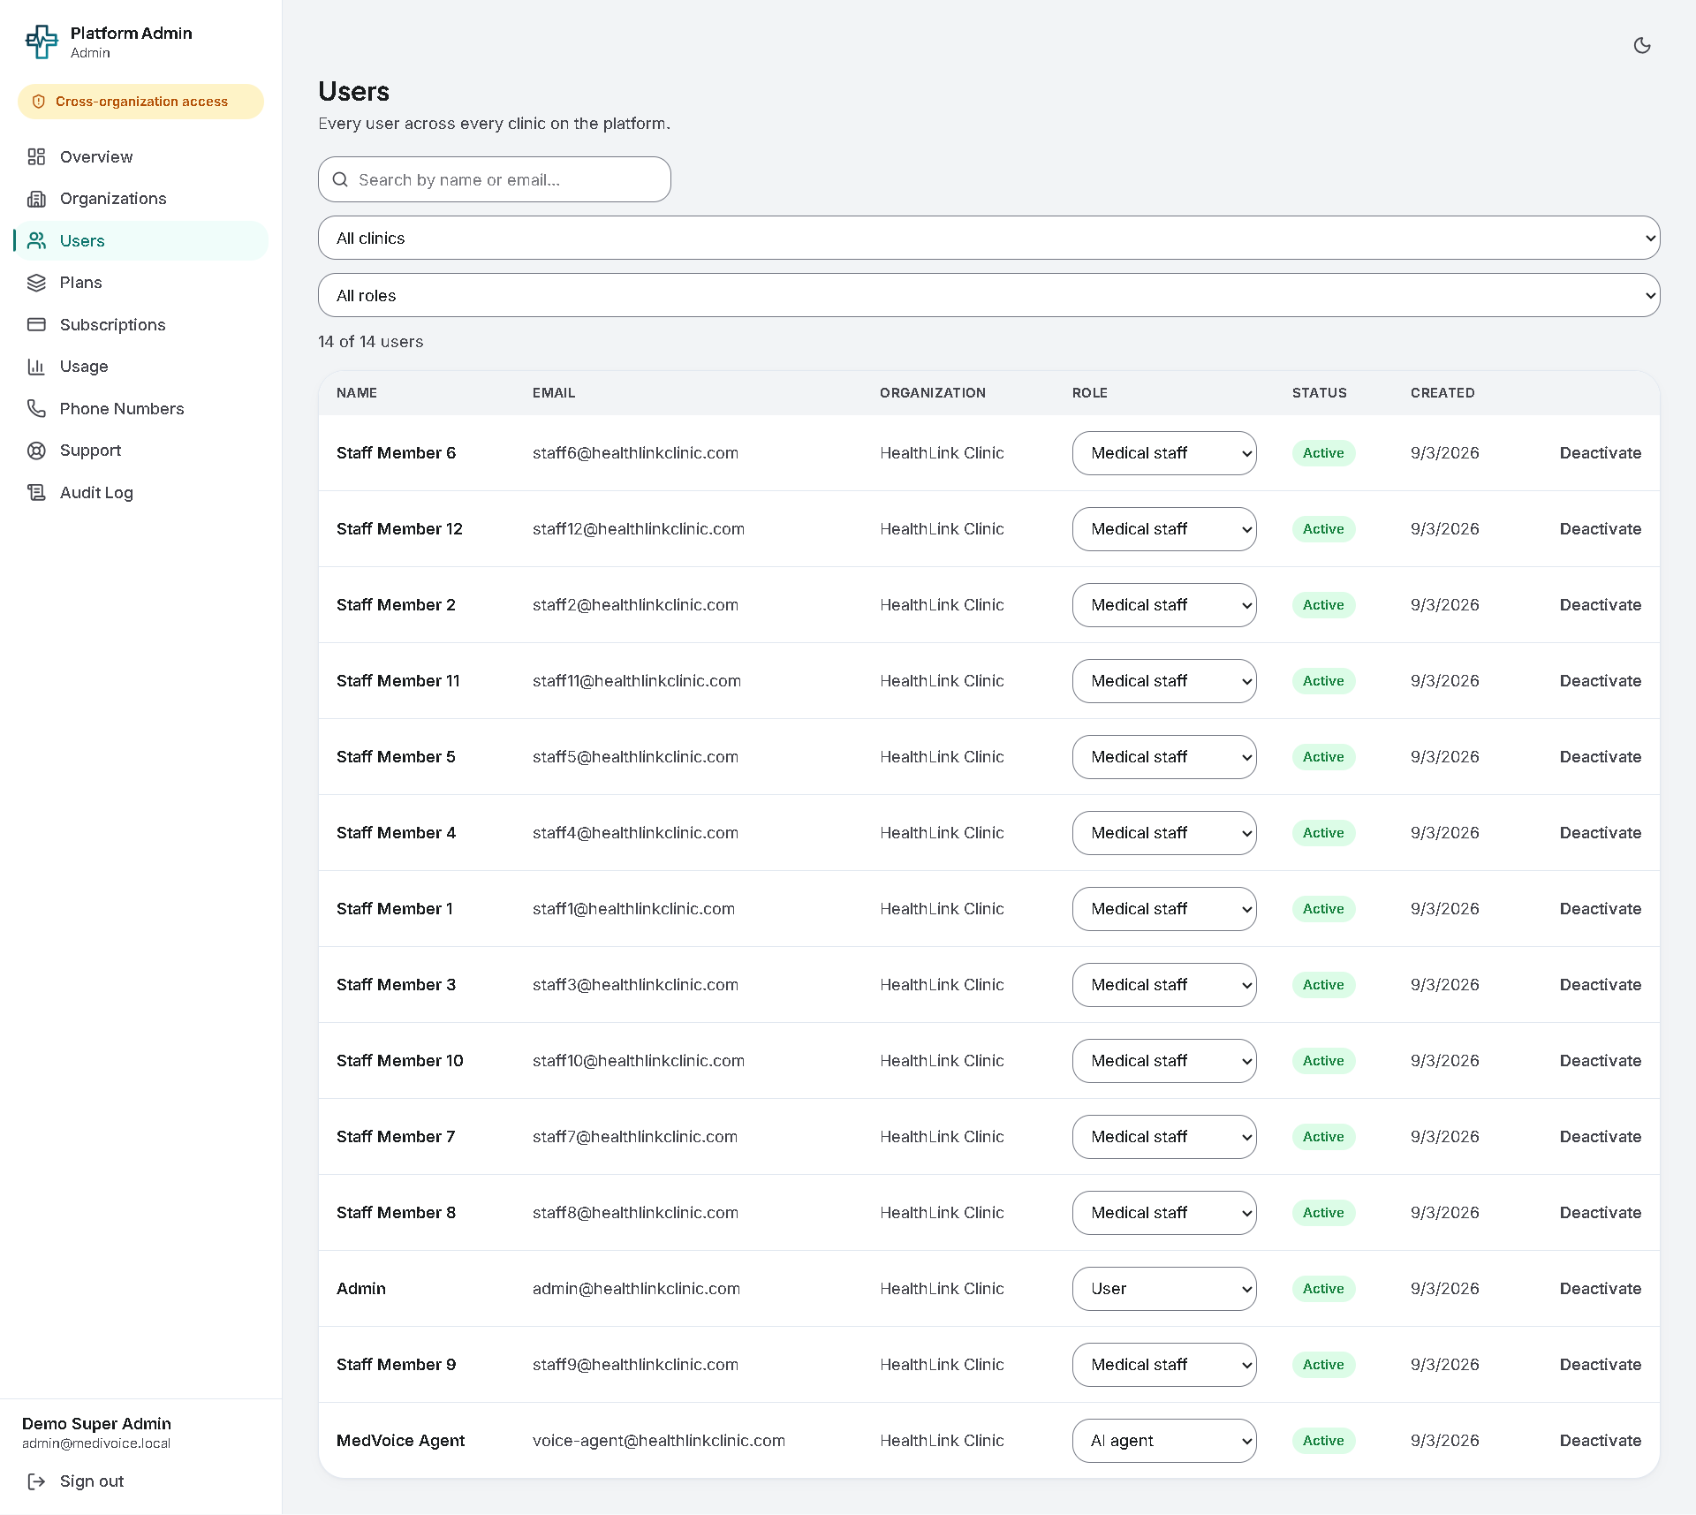
“The Platform Admin Users section provides a cross-organization view of all users across the platform. Administrators can review their organization, role and status and deactivate accounts when necessary.”

Slide 28
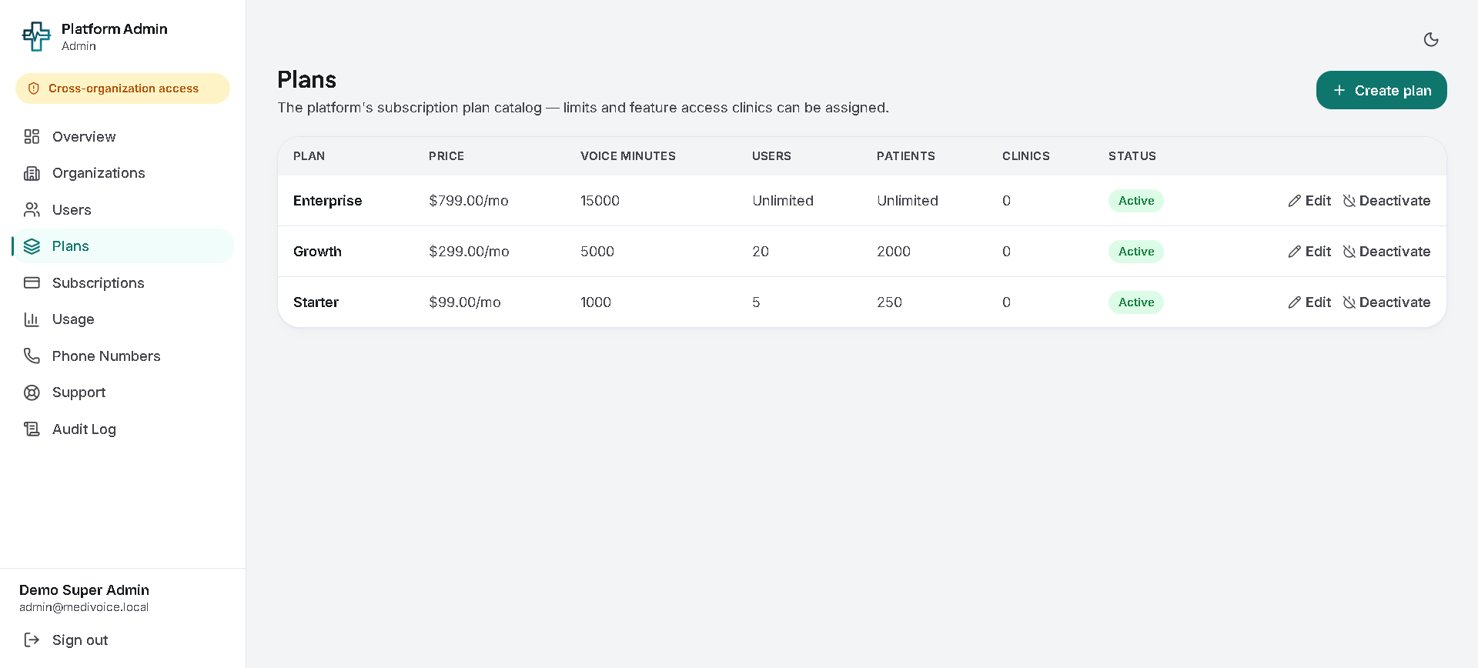
“The Plans module allows the platform administrator to define the subscription packages offered by MediCOR AI, including pricing, voice-minute limits, user limits and patient limits.”

Slide 29
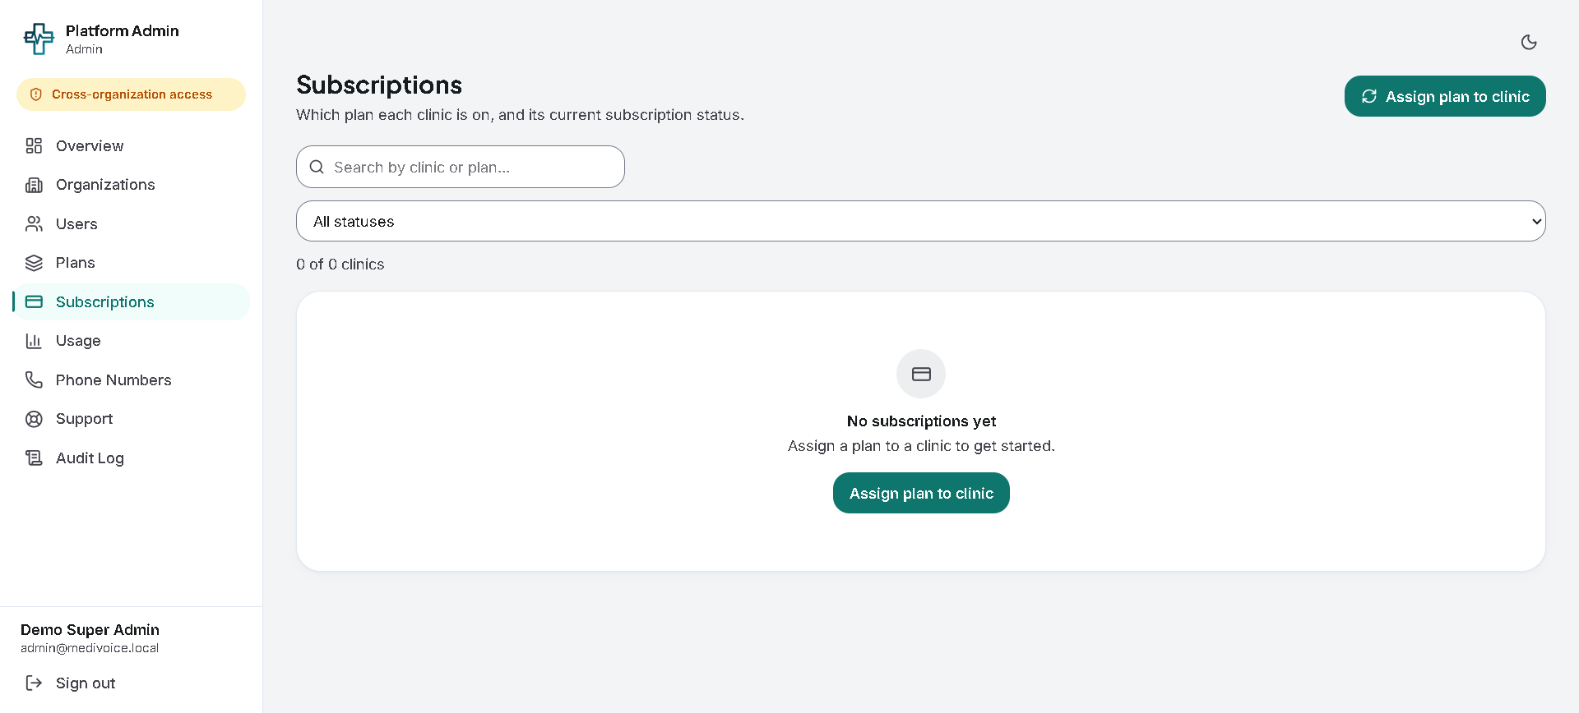
“The Subscriptions module manages the relationship between clinics and their subscription plans. The Platform Admin can assign a plan to a clinic and monitor the subscription status.”

Slide 30
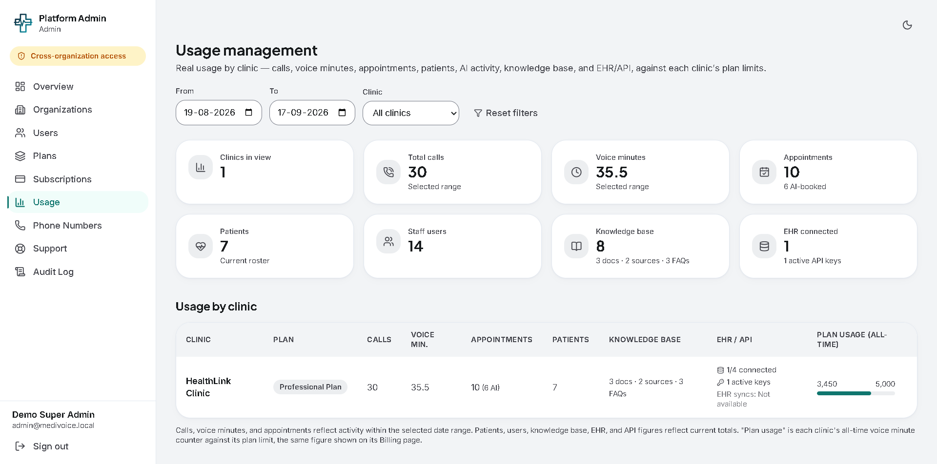
“Usage Management provides the platform team with a centralized view of how clinics are consuming MediCOR AI resources and how that usage compares with their subscription limits.”

Slide 31
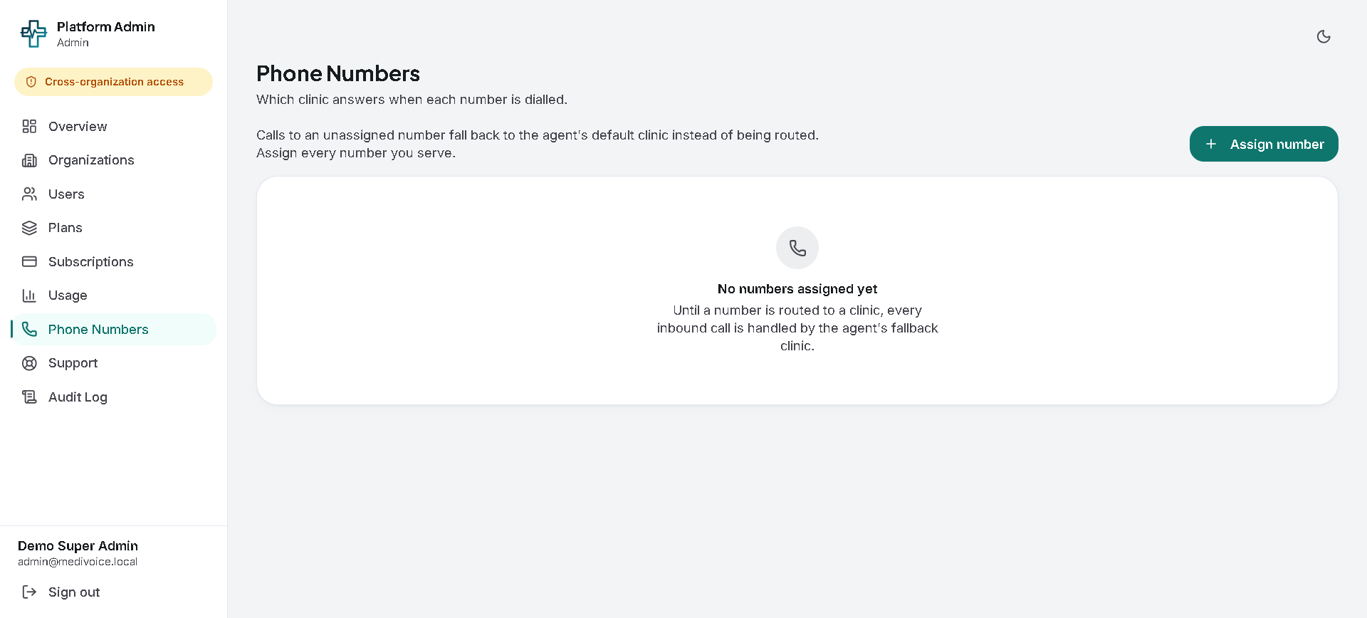
“The Phone Numbers module manages the mapping between incoming phone numbers and clinics. This allows the platform to determine which clinic's AI receptionist should handle an incoming patient call.”

Slide 32
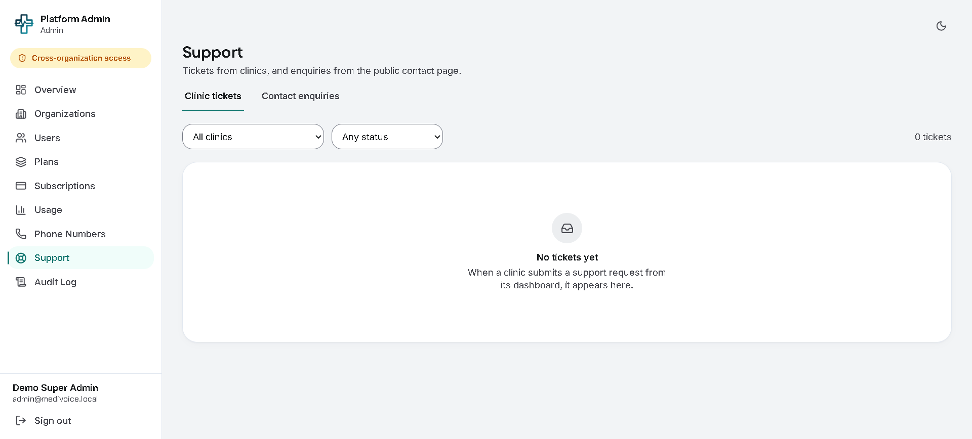
“The Platform Support module centralizes support requests from existing clinics and enquiries received through the public website, allowing the platform team to monitor and manage them.”

Slide 33
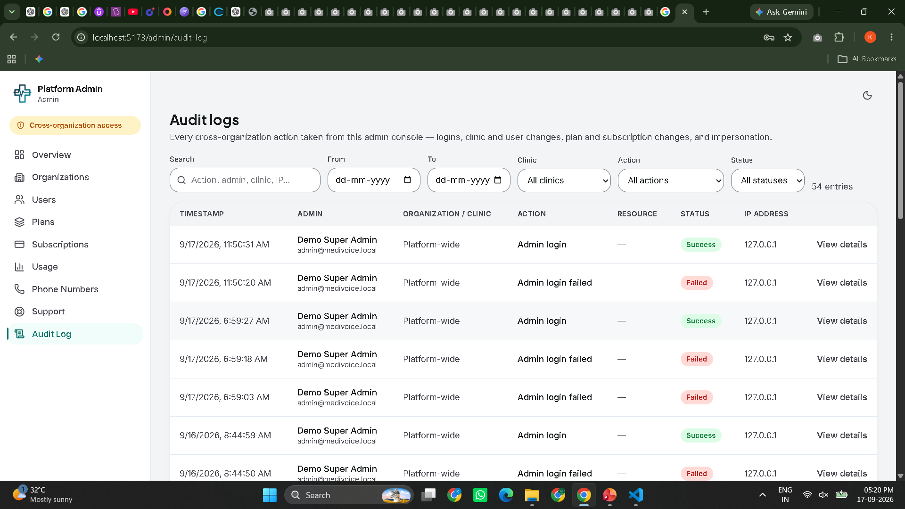
“Audit Logs provide a traceable history of important administrative actions across the MediCOR AI platform. This allows the platform team to understand who performed an action, when it occurred, which organization was involved and whether the operation succeeded or failed.”

